Slide 1
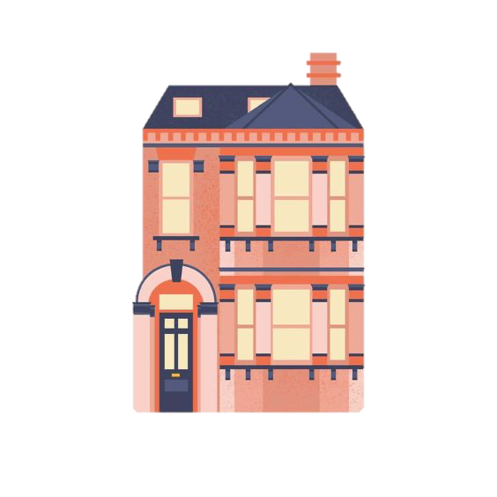
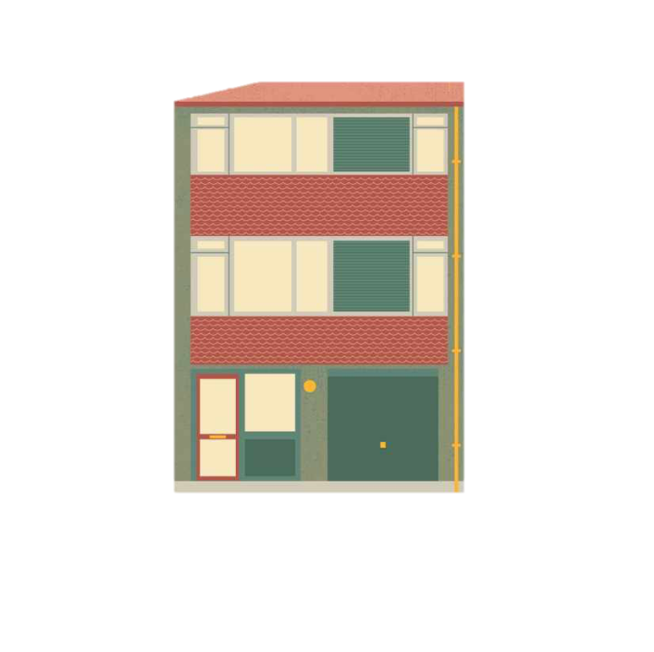
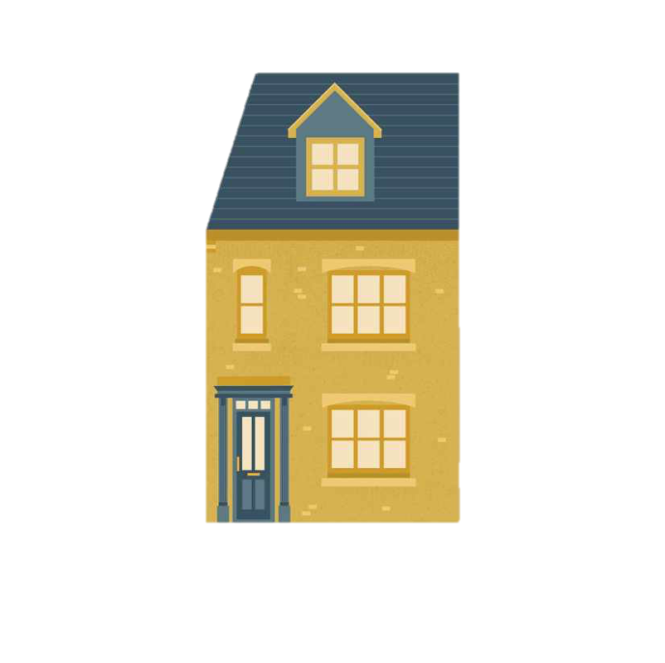
MY DREAM HOUSE
VOTE FOR YOUR FAVOURITE PROJECT

Slide 2
SUBJECT
Le célèbre architecte anglais, Norman Foster, est à la recherche d’un nouveau projet. A vos crayons, pinceaux ou ordinateurs ! Proposez-lui votre version d’une maison imaginaire. Attention, tout projet ordinaire, banal ne pourra prétendre remporter le concours !

Slide 3
INSTRUCTIONS
1 catégorie: BEST ORIGINAL DREAM HOUSE
1 seul vote par personne

Slide 4
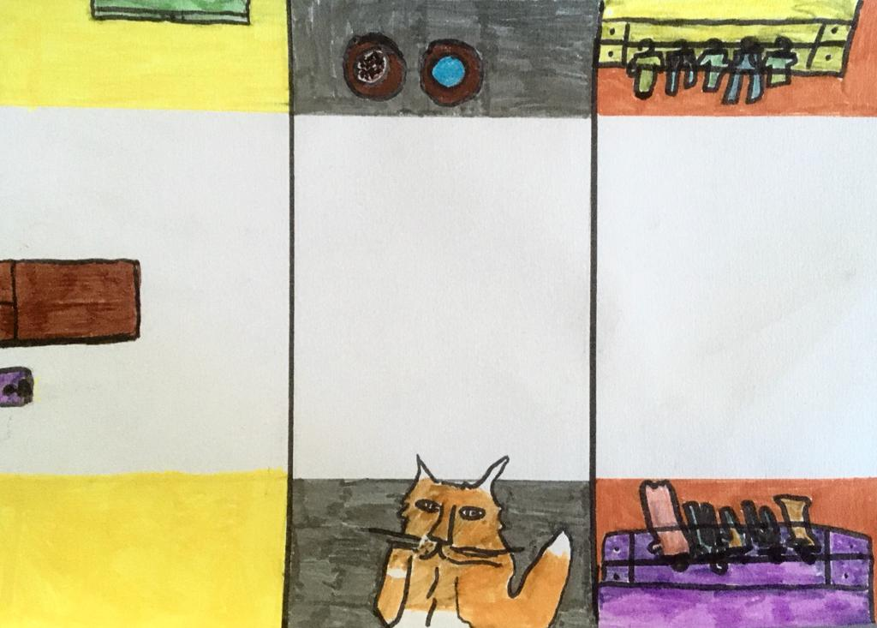
PROJECT #1 – Hommer House
This is my imaginary house. Its name is Hommer. There are three floors. On the 3rd floor, there are three rooms: the playing video games room, the spare bedroom where there is the animal room, and the spare bedroom where there is a bed in the middle and a sport room.
On the 1st floor, there is the kitchen and the dining room. The table is in the middle with chairs around.
On the 2nd floor, there is the animal room. The cats are on the right and on the left, there is cat food. Also there is a walk-in closet: on the right it is for male clothing and on the left it is for female clothing. Finally there is a bedroom.
Architect: Zoe

Slide 5
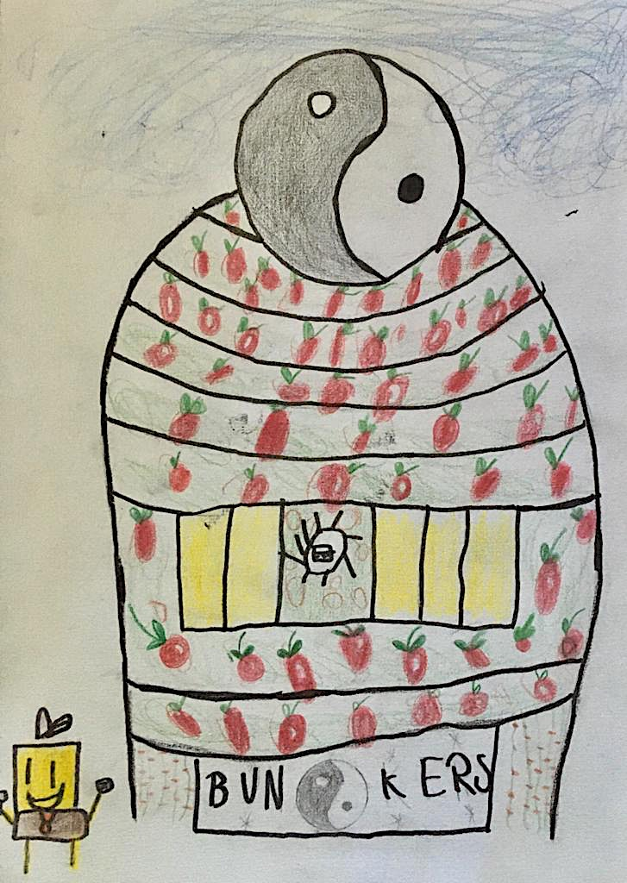
PROJECT #2 – BIKINY BOTON
This is my imaginary house. Its name is BIKINY BOTON because it is underwater. The tower is made of there floors and the attic where there is my bedroom.
In my bedroom there is a big blue bed. Next to it there are the treasure rooms. Next to it I have a red lamp. In front of my bed there are bookshelves on the left and on the right there is a green sofa where I enjoy reading. Moreover there is a secret room and also bunkers.
Finally the house is full of plants!
Architect: Armin

Slide 6
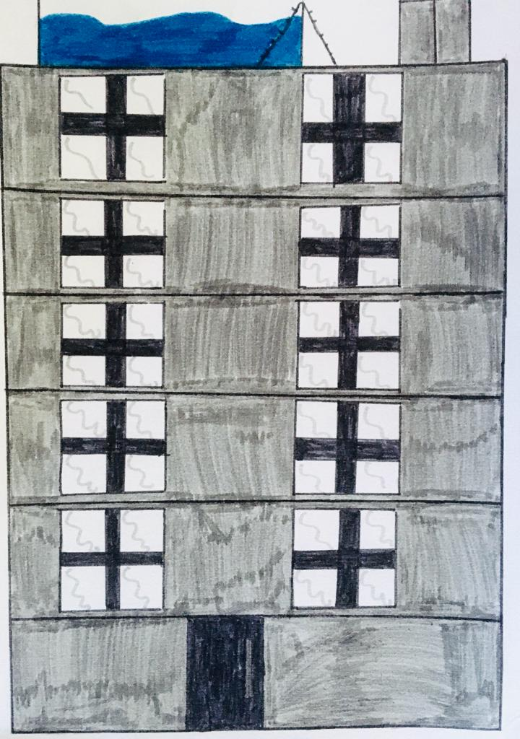
PROJECT #3 – Paradise Tower
This is my imaginary house. Its name is Paradise Tower because it is original. In the Parasite Tower, there is a garden. On the first floor, there is a living room where my family and I watch TV. In the living room, there is a sofa. On the chest of drawers, there is a TV.
On the third floor, there is a kitchen. In the kitchen, there is a fridge. Next to the fridge, there is a table where my family eats.
On the fifth floor, there is a bed. In the middle, there is a bed. Also, on the right there is a desk. On the desk, there is a computer. On the opposite, there is a wardrobe.
Finally, on the last floor, there is an open swimming pool where you can look at the city.
Architect: Winner

Slide 7
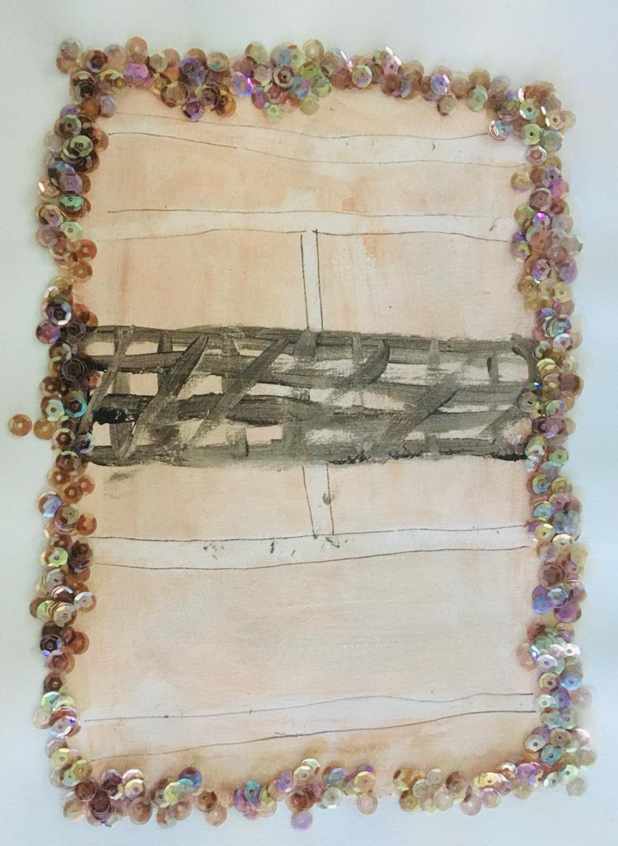
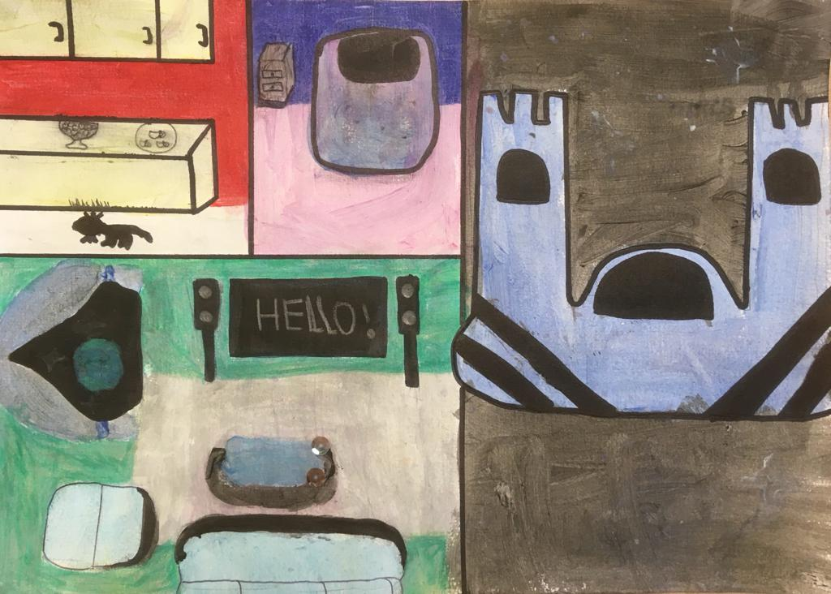
PROJECT #4 – Cleopatra House
This is my imaginary palace. It is a mix between a star-ship and a castle. She floats in the sky. Its name is the Happiness Starship because there is everything you want. The star-ship is made of five floors, the basement and the attic where there is the tennis court.
In the basement, there is the room of the cat-servants. On the ground floor, there is the living room where I like watching TV with my family. The huge screen is in the middle, in the back, with on both side, two speakers. Also, there is a giant floating sofa. There is a coffee table full of led and a bow window where you can look the space! It is beautiful!
There is a large corridors leading to the kitchen where the cat-servant prepare food. There is a large work surface and a fridge.
Finally, my bedroom on the 4th floor. There is a huge bed with water in the middle and floating bedside table.
Architect: Nessma

Slide 8
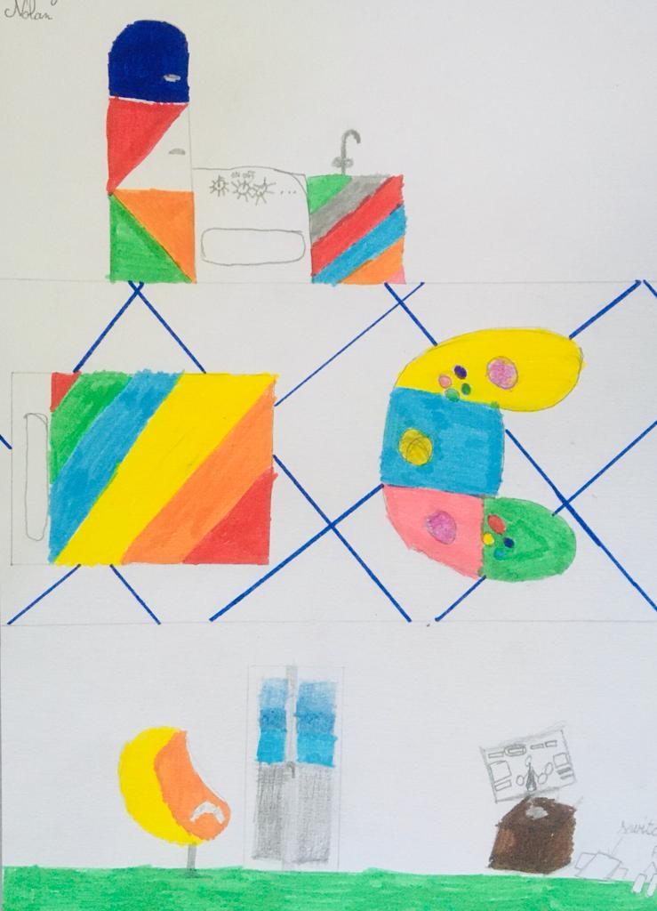
PROJECT #5 – Gamer House
This is imaginary house. Its name is Gamer House because it has the shape of a switch My house has four rooms: there is a kitchen room, a gaming room, a bathroom, a bedroom.
On the left there is a gaming room and a bedroom. On the right there is a living room a dining room and a kitchen. You can eat meat and veggies. In the gaming room there is a PS4, PS5, X-BOX and a switch.
In the bedroom there is a big bed and a big carpet in the shape a gamepad.
Finally my kitchen is very very big !
Architect: Nolan

Slide 9
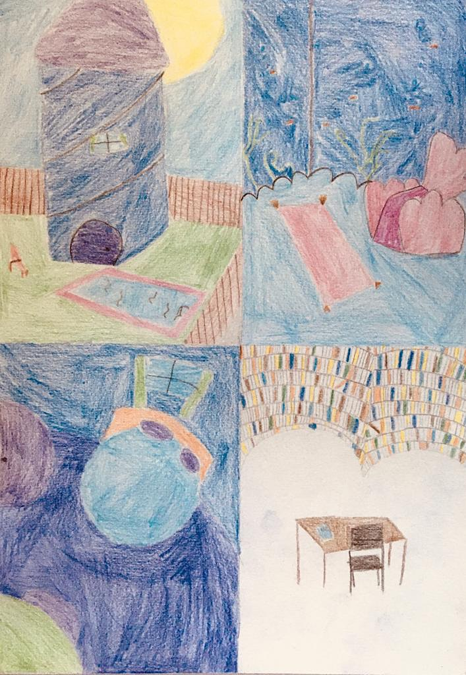
PROJECT #6 – Shape House
This is my imaginary house. Its name is Shape House. Also, it is a blue and purple spiral house.
My living room has the shape of a cloud. The sofas are in the shape of seashelves with aquarium walls full of fish.
My bedroom is circular. There is a round floating bed. Then, the room is entirely blue : the desk, the bed, the wardrobe…
The library has the shape of a flower. It is very big. It is full of brooks.
There are three bathrooms, a lot of bedrooms, two kitchens and two very, very, very big gardens with a pool.
Finally, this is the kitchens where I can’t stand cooking and we can be messy in this house!
Architect: Ambre

Slide 10
PROJECT #7 – Star House
This is my imaginary house. It’s name is star because I am the star. The star is made of two floors.
On the ground floor, there is a kitchen there is also a living room. In the living room there is a TV and also a sofa.
On the second floor there are three bathrooms. Next to the bathroom, there is my bedroom with a bed, a desk and also a walking closet.
Finally, I like the house and I love the bathroom.
Architect: Camelia

Slide 11
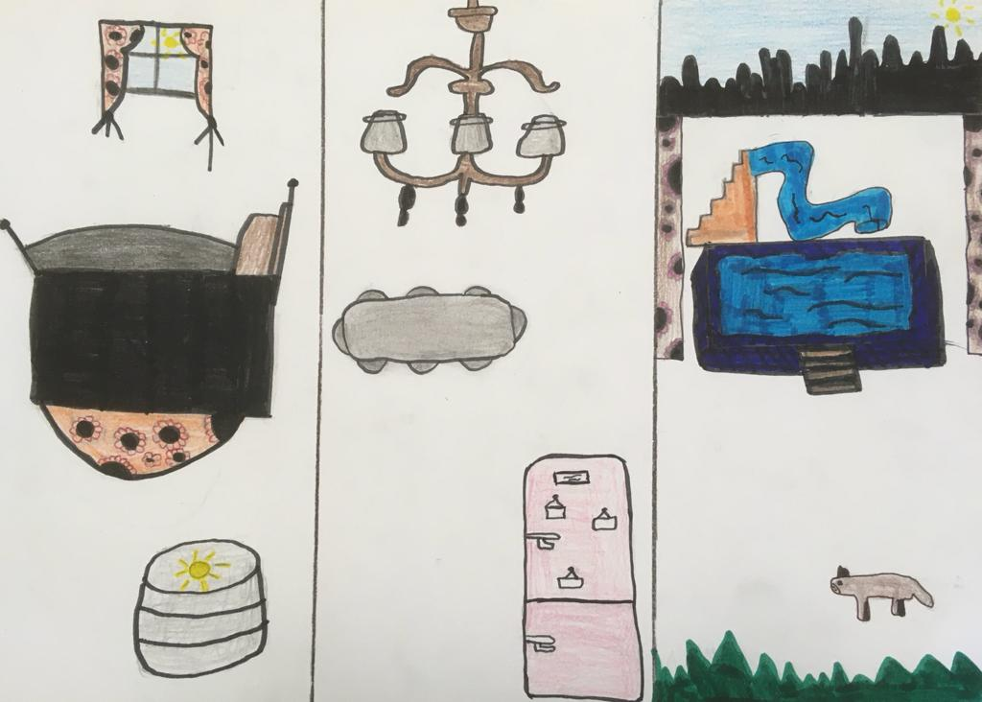
PROJECT #8 – Happiness House
This my imaginary house. lts name is Happiness House because it is full of life. In my bedroom, there is Huge ottoman. And is very big black bed. There, in the kitchen there is always food. There is a big fridge and on the fridge there a lot of family photos. Finally there is a big swimming pool with a huge toboggan in the garden. There are also flowers and a big dog to protect the garden.
Architect: Nora

Slide 12
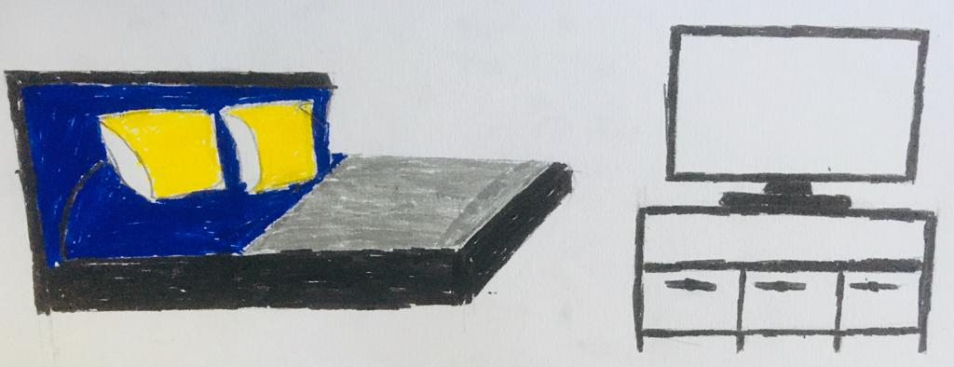
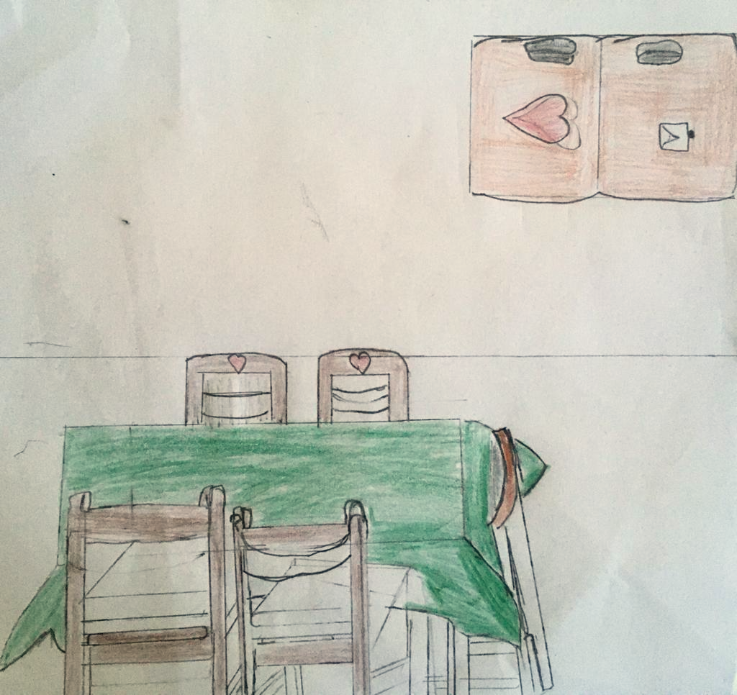
PROJECT #9 – Untitled House
My house has two kitchens, a living room, and two dining rooms.
In my bedroom there is a big TV and a large black bed.
In the kitchens, there are a bid fridge.
In the dining room, there is a long table and ten chairs.
Architect: Ulrich

Slide 13
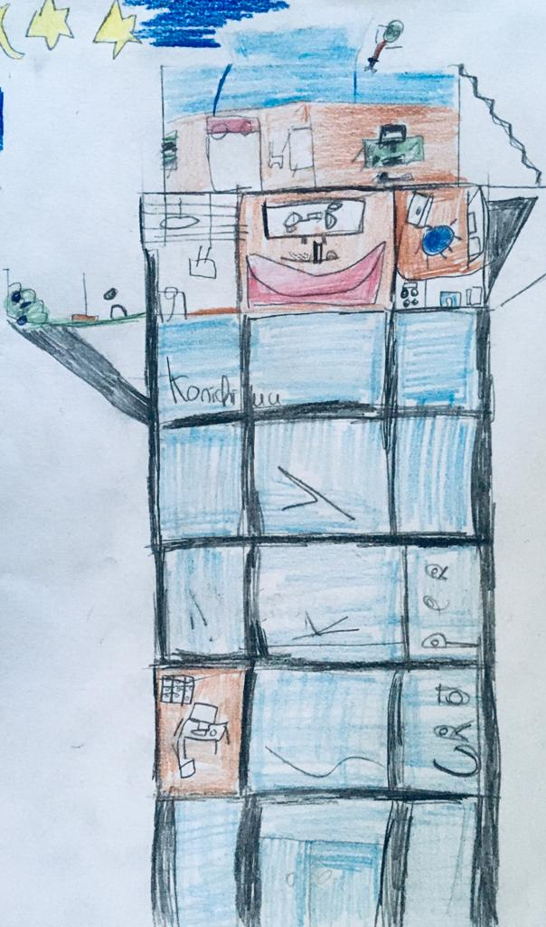
PROJECT #10 – Konichiwa SkyCraper
This is my imaginary house. Its name is , Konichiwa SkyCraper. I have a private skyscraper. In my Skyscraper, there are 2500 floors. My private master bedroom is on the last floor. In my master bedroom, there is an automatic kitchen. Everything is automatic: the fridge, the dishwasher... This is where I like cooking.
On the ground the floor there is a living room, the garden, the bathroom, the library and the toilets.
On the first floor there is my second bedroom. My bedroom is ordinary there is a bed , a wardrobe, a chest of drawers, and a bookshelf. Moreover my bedroom is tidy. I have a safe in my bedroom on the wall. Next to my bedroom, I have an office where I have a desk to work.
Finally, on the roof, there is a swimming pool where you can look at the sky full of stars.
Architect: Fadel

Slide 14
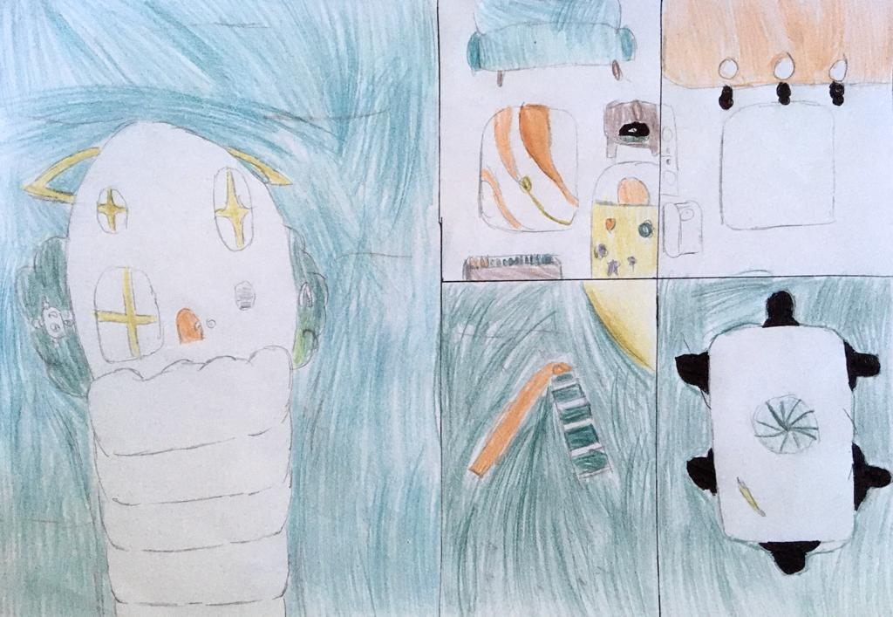
PROJECT #11 – Paradise House
This is my imaginary house. Its name is the Paradise House because my house is on a cloud.
In my bedroom there is a big blue bed. Next to it I have an alarm clock. Above my bed there are bookshelves. On the right there is a big blue sofa where I like sleeping.
In my kitchen, where I like cooking, there is a big yellow carpet and a white fridge. In the white fridge there is lot of food. There is also a family picture.
In the garden there are two yellow reading chairs, a table, a big sweater, and a toboggan. On the table there is a big melon and also bananas.
Architect: Youva

Slide 15
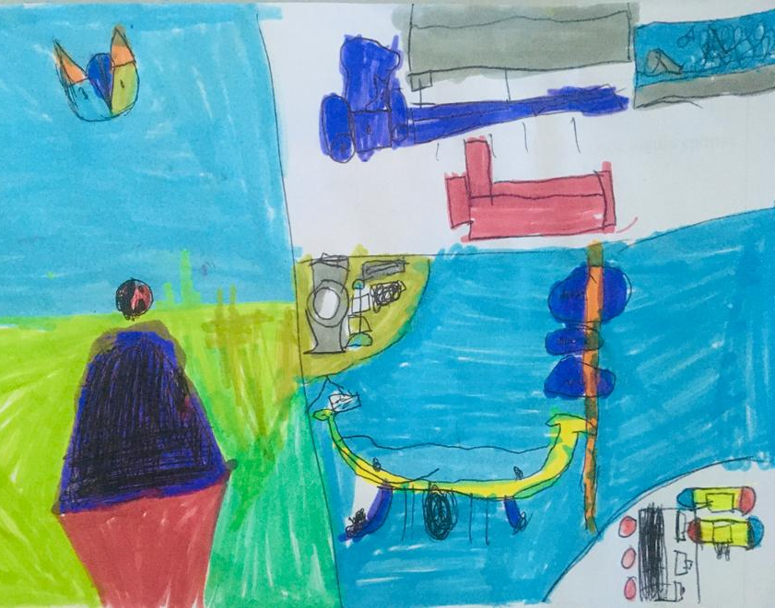
PROJECT # 12 – The Magic Doors
This is my imaginary house. Its name is The Magic Doors because is it magic.
The door as one floor and an attic. In the attic there is my video games. There are two Xbox and three Switch.
There are two basements where there is an amusement arcade. Above there is my bedroom where there are fifty beds. On the left there are two sofas and a TV.
Architect: Anatole

Slide 16
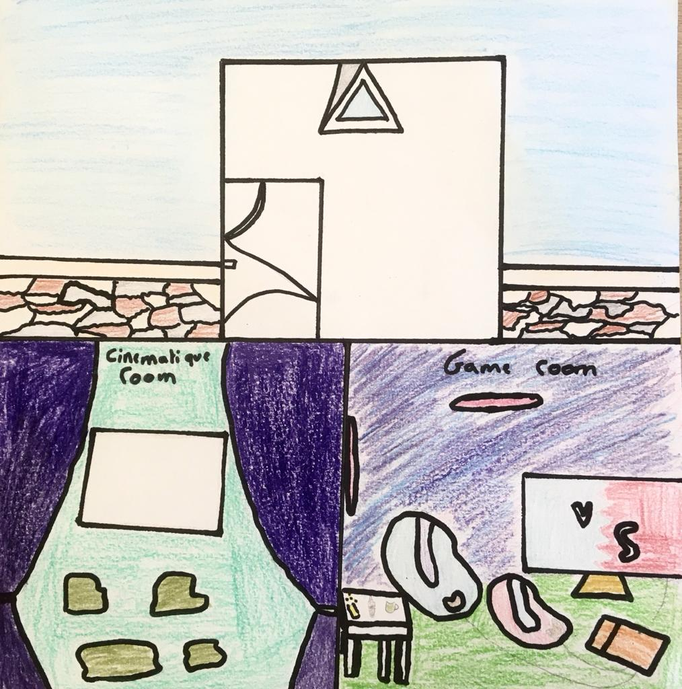
PROJECT #13 – Square House
This is my imaginary house. Its name is Square House. It is a big palace with a big swimming pool in the garden and in the house.
In the house there are two floors. On the first floor there is a cinema room and a living room where there is a big TV. On the opposite of the living room there is a big kitchen.
On the second floor there are five bedrooms. Finally, there is a video game room to play.
Architect: Zahide

Slide 17
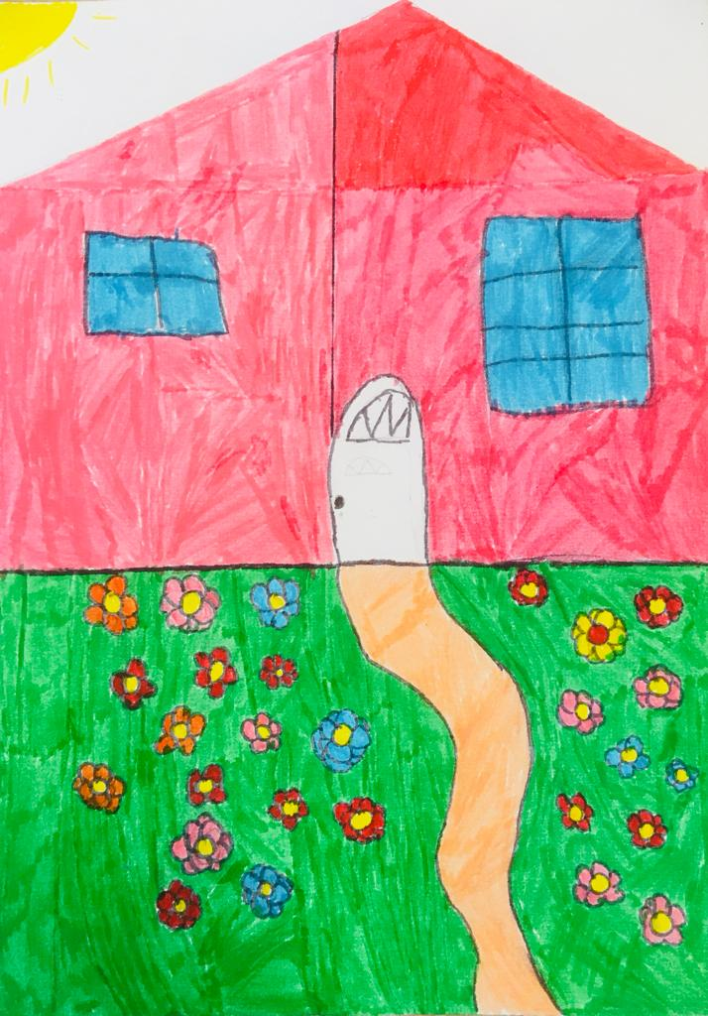
PROJECT #14 – Cutihouse
This is imaginary house. Its name is Cutihouse. In front of my house there is a big garden with beautiful flowers. In my house there is a secret. It is hidden in my fridge. You must push an egg and it opens! This is the secret room where I like watching TV. This room pink and huge.
In my house there is a kitchen where I hate doing the dishes however I love cooking here. This is where I play hide and seek with my sisters.
In my living room there is a little pink TV. In front on my TV, there is a comfy little pink sofa. There is also a coffee table.
Finally, my bedroom is pink and white with pink glitters. Moreover, in my bedroom they are posters. On a poster you can read “You must sleep at night and mustn’t use your phone”. My bed is where I like listening to music.
Architect: Prunelle

Slide 18
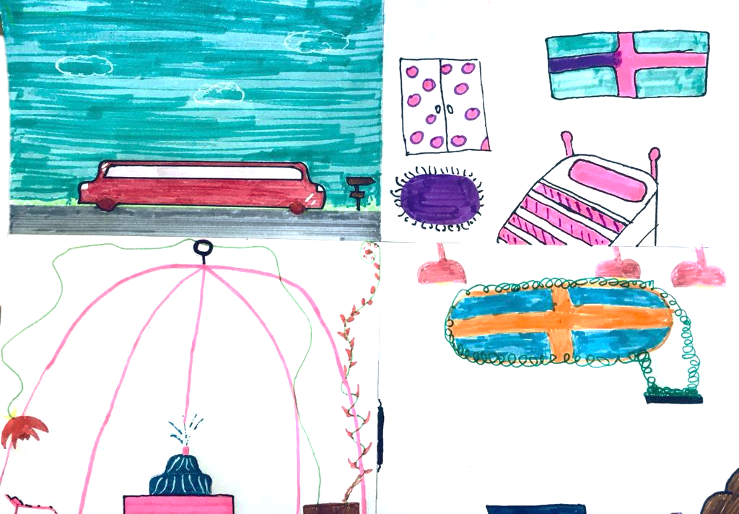
PROJECT #15 – Secret Limousine
This is my imaginary house. Its name is Secret Limousine because it is a unique limousine. There are four floors and the magic attic. On the fourth floor there are five bedrooms. Each has its bathroom. On the third floor there is a secret garden.
On my desk there is a big computer. On the ground floor, there is a kitchen where I like cooking. However, I must clean the dishes. Also, there is the living room where there is a big sofa and a TV. It is comfy. Finally, my secret limousine is pink and takes me everywhere.
Architect: Asel

Slide 19
#1 – Hommer House
#8 – Happiness House
#4 – Cleopatra House
#12 – The Magic Doors
#11 – Paradise House
#15 – Secret Limousine
#10 – Konichiwa SkyCraper
#9 – Untitled House
#13 – Square House
#3 – Paradise Tower
#7 – Star House
#5 – Gamer House
#2 – BIKINY BOTON
#6 – Shape House
#14 – Cutihouse

